Slide 1
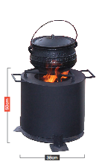
SMALL Mashesha
• Fits size 2 to 4 three legged pots
Flat pots and pans up to 5L
Fixed ash collector
3 fixed feet
Height: 50cm I Width: 38cm I Mass: 8.5kg
• Fits size 2 to 4 three legged pots
• Flat pots and pans up to 5L
• Fixed ash collector
• 3 fixed feet
The Small Mashesha Stove is made with 1.2mm Mild Steel and is painted with a high heat black paint. Fuel sources: wood, charcoal or any biomass briquette.

Slide 2
Mashesha Stoves use 50% less wood. Saving on wood means that costs can be recovered in approximately 5 months. It also produces less smoke than an open fire which is better for the environment and the chef’s health.
Louise Williamson
Cell: 072 436 8347
E-mail: louise@masheshastoves.com
Web: www.Masheshastoves.com

Slide 3
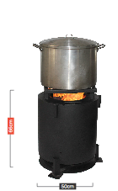
LARGE Mashesha
• Fits size 2 to 4 three legged pots
Flat pots and pans up to 5L
Fixed ash collector
3 fixed feet
Height: 66cm I Width: 50cm I Mass: 25kg
•. Removable triangle
pot standFlat pots
up to 50L
•. Fixed ash collector
•. 3 fixed feet
•. Pot support rods
The Small Mashesha Stove is made with 1.2mm Mild Steel and is painted with a high heat black paint. Fuel sources: wood, charcoal or any biomass briquette.

Slide 4
Mashesha Stoves use 50% less wood. Saving on wood means that costs can be recovered in approximately 5 months. It also produces less smoke than an open fire which is better for the environment and the chef’s health.
Louise Williamson
Cell: 072 436 8347
E-mail: louise@masheshastoves.com
Web: www.Masheshastoves.com

Slide 5
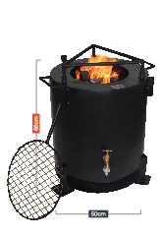
Three-in-One
Mashesha
• Fits size 2 to 4 three legged pots
Flat pots and pans up to 5L
Fixed ash collector
3 fixed feet
Height: 66cm I Width: 50cm I Mass: 33kg
•. Removable triangle
pot stand
•. 40L water jacket
•. Flat pots up to 50L
•. Fixed ash collector
•. 3 fixed feet
•. Pot support rods
The Small Mashesha Stove is made with 1.2mm Mild Steel and is painted with a high heat black paint. Fuel sources: wood, charcoal or any biomass briquette.

Slide 6
Mashesha Stoves use 50% less wood. Saving on wood means that costs can be recovered in approximately 5 months. It also produces less smoke than an open fire which is better for the environment and the chef’s health.
Louise Williamson
Cell: 072 436 8347
E-mail: louise@masheshastoves.com
Web: www.Masheshastoves.com

Slide 7
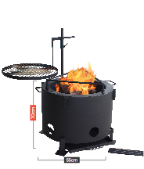
Fire Pit
Mashesha
• Fits size 2 to 4 three legged pots
Flat pots and pans up to 5L
Fixed ash collector
3 fixed feet
Height: 70cm I Width: 55cm I Mass: 40kg
• Adjustable 54cm wide
braai grid
• Flat pots and pans up
to 70L or 4 medium pots
• Removable ash collector
4 fixed feet
The Small Mashesha Stove is made with 1.2mm Mild Steel and is painted with a high heat black paint. Fuel sources: wood, charcoal or any biomass briquette.

Slide 8
Mashesha Stoves use 50% less wood. Saving on wood means that costs can be recovered in approximately 5 months. It also produces less smoke than an open fire which is better for the environment and the chef’s health.
Louise Williamson
Cell: 072 436 8347
E-mail: louise@masheshastoves.com
Web: www.Masheshastoves.com

Slide 9
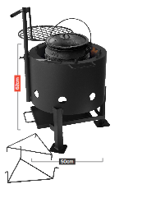
Potjie
Mashesha
• Fits size 2 to 4 three legged pots
Flat pots and pans up to 5L
Fixed ash collector
3 fixed feet
Height: 62cm I Width: 50cm I Mass: 20kg
•. Adjustable 40cm wide
braai grid
•. Fits up to a size 4 three
legged pot
•. Removable pot stand for
flat pot/skottle cooking
•. Removable ash collector
3 fixed feet
The Small Mashesha Stove is made with 1.2mm Mild Steel and is painted with a high heat black paint. Fuel sources: wood, charcoal or any biomass briquette.

Slide 10
Mashesha Stoves use 50% less wood. Saving on wood means that costs can be recovered in approximately 5 months. It also produces less smoke than an open fire which is better for the environment and the chef’s health.
Louise Williamson
Cell: 072 436 8347
E-mail: louise@masheshastoves.com
Web: www.Masheshastoves.com

